Slide 1
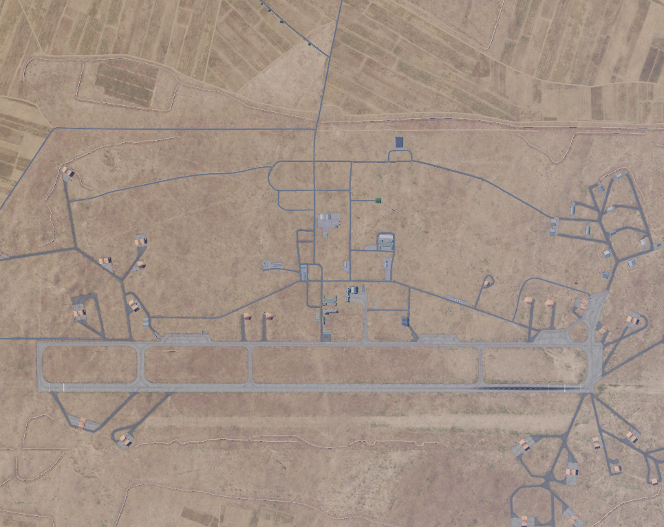
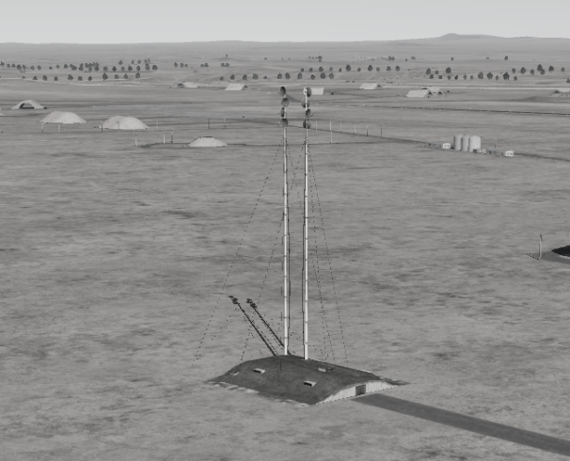
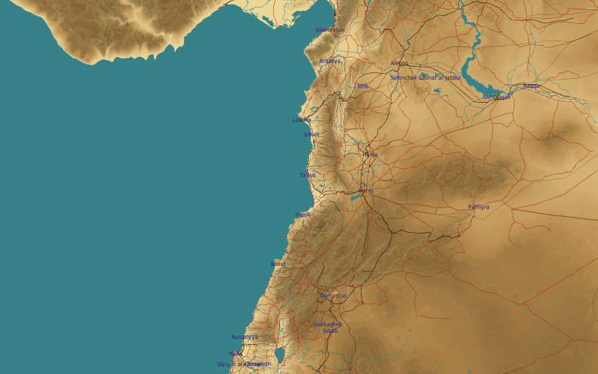
OPARTGT067 SCC SOUTH
N
N
1
67
DESCRIPTION OF THE DESIRED POINTS OF IMPACT WITH WPN TYPE:
OPARTGT067A – SCC East
DPI 1 N33 37.178 E036 44.844/2067ft /(2000 Ibs bomb)
OPARTGT067A – Reinforced poured concrete bunker covered with approximately 1m of earth. Requires delayed fuzing.
4
5
6
DPI lays within the boundaries of Al-Dumayr Airfield.
7
8

